Slide 1
Personal Residential Model
FPHLM
Florida Public Hurricane Loss Model
Notes:
Draft for the question 1.
Responded by: Boback
Submitted to: Prof. Pinelli

Slide 2
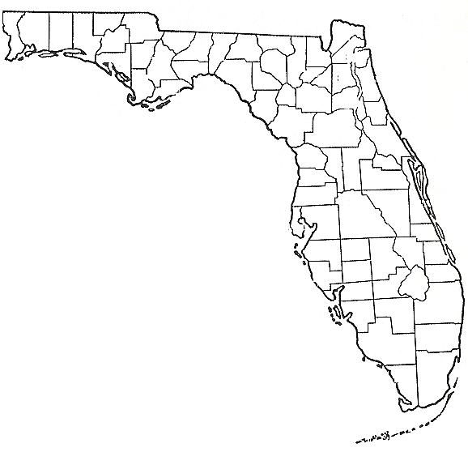
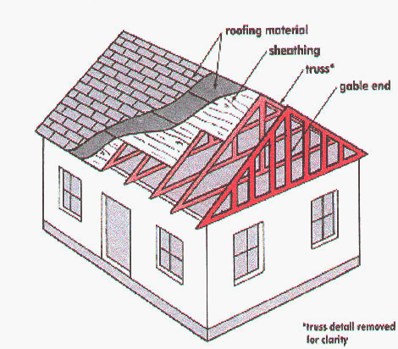
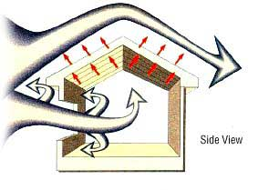
Research Objectives
Translate wind speed into loads
Quantify wind resistance
Determine types
%
Quantify
damages
Monte Carlo Simulation
Overview slide 2

Slide 3
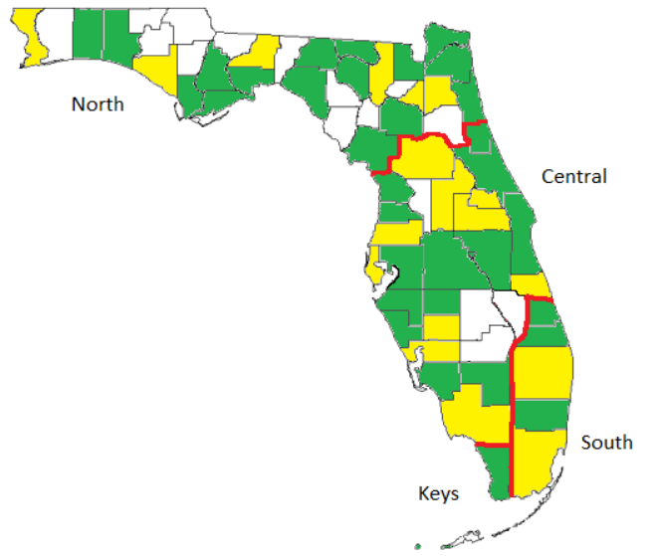
Sampling Plan
(Surveyed Counties and Regions)
Property Appraiser Data Bases
  Varies from county to county
  67 Counties were contacted
  Statistical Survey on 51 Counties
    Yellow: 2014 tax roll
    Green: pre-2014
  Population Coverage: 97%
  Statistical Data in Regional and County Level
  Statistical Data inside each Era
Overview slide 3
Notes:
Blue color in the map indicates the surveyed counties.
For the purpose of analyzing the data, the state was divided into four main regions including: North, Central, South and Keys. Monroe County is kept as a separate region because of its unique geographical location (island keys prone to hurricanes). Geography and the statistics from the Florida Hurricane Catastrophe Fund (FHCF) provided guidance for defining regions that would have a similar building mix. For example, North Florida has primarily wood frame houses while South Florida has primarily masonry houses.

Slide 4
Resulting Classification
Roof Cover | Roof Type | Exterior Wall | Number of Story
Shingle | Gable | Wood frame | 1
Tile - Metal | Hip | Masonry | 2
Others | Other | Other | more
Overview slide 4

Slide 5
Research Objectives
Translate wind speed into loads
Quantify wind resistance
Determine types
%
Quantify
damages
Monte Carlo Simulation
Overview slide 5

Slide 6
Wind Speed → Wind Load
Translate wind speed to the pressures and forces on the building
Overview slide 6

Slide 7
Component Wind Loads
Input
Output
Discrete 3 sec
wind speed
(e.g.V = 110 mph)
Component
loads/pressures
(e.g. one sheathing panel)
Sources:
  Wind load provisions in code
  Directional modifications
  Full scale measurement
Influences:
  Building shape
  Wind direction
Overview slide 7

Slide 8
Research Objectives
Translate wind speed into loads
Quantify wind resistance
Determine types
%
Quantify
damages
Monte Carlo Simulation
Overview slide 8

Slide 9
Component Resistance to Wind
For each structural type
  Identify major components
  Model the capacity of each component
  Determine Load Paths
Overview slide 9

Slide 10
Residential Components
Type: e.g., Concrete Block, Gable Roof
5 Selected components
  Roof cover
  Roof sheathing
  Roof to Wall Connections
  Walls (frame, masonry)
  Openings
Overview slide 10
Notes:
A typical residential house is modeled as shown. It has five possible damage mode:
Roof cover failure
Sheathing failure
Opening failure
Wall failure
Wall to roof connection failure

Slide 11
Research Objectives
Translate wind speed into loads
Quantify wind resistance
Determine types
%
Quantify
damages
Monte Carlo Simulation
Overview slide 11

Slide 12
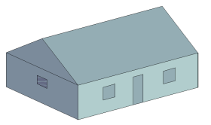
Monte Carlo Simulation Engine
Roof Cover
Roof Sheathing
INPUT
Roof to Wall
Random 3 sec
wind speed
(e.g.V = 110 mph
With COV = 0.1)
Connections
Walls
Openings
LOAD: Modified Pressure
Coefficients from ASCE 7
Randomized
DAMAGE
Random component
capacities
Overview slide 12
Notes:
A typical residential house is modeled as shown. It has five possible damage mode:
Roof cover failure
Sheathing failure
Opening failure
Wall failure
Wall to roof connection failure

Slide 13
Damage Prediction
Damage Matrix for:
  Each structural type
  Wind speeds 50 – 250 mph in steps of 5 mph
  Eight wind directions
Overview slide 13
Notes:
Nick – this slide is best viewed in the slide show mode, so you can see the progression.
First explain that we multiply each damage prediction matrix value by the % cost damage associated with that state of damage. The cost is expressed as the ratio between repair cost and total replacement cost.
Next – sum over all the possible damage states for that bldg type at a given wind speed. Now we have used the information from all of the cells in one damage prediction matrix.
Meteorology team provides input on the likelihood of maximum 3 second gust wind speed occurrence. Use this information to sum over all relevant wind speeds for the bldg type

Slide 14


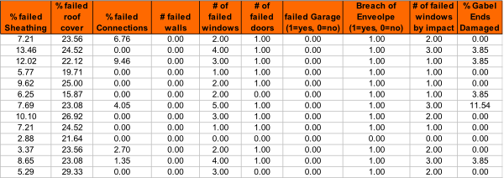
Example Damage Matrix
Partial sample of an output file for a concrete block home, in South FL, with a gable roof, and no hurricane shutters, subjected to a 150 mph 3-sec wind gust at an angle of 45 degrees

Slide 15
Research Objectives
Translate wind speed into loads
Quantify wind resistance
Determine types
%
Quantify
damages
Monte Carlo Simulation
Overview slide 15

Slide 16
Cost Estimation Model
%
From the Damage Matrices
  Convert modeled physical damages into monetary damages
  Define the vulnerability of different homes types
  Provide a logical method for prediction damage to other coverage’s
  Validate the damage predictions
  Input from experts (adjusters, etc.)
Overview slide 16

Slide 17
Different Types of Damage
%
Overview slide 17

Slide 18
Vulnerability Matrices
Model Type - Specific to each Monte Carlo model (36 models) plus additional considerations for each (6*36 = 216)
Overview slide 18

Slide 19
Weighted Matrices
Insurance Portfolio
Location: Define region and sub region.
Year Built: use as proxy for Strength (Weak, Medium, Strong).
Type of exterior wall.
Roof shape, roof cover, number of stories, and opening protection options are undefined.
The weighted matrices are the sum of the corresponding vulnerability model matrices weighted on the basis of the statistical distributions;
The user has the option to predict the type of the building (use non_weighted) or use weighted matrices.
Overview slide 19

Slide 20
Mapping of Vulnerabilities to Insurance Policies
case 1 is the case where all parameters are known
Insurance Portfolio Data | Year Built | Exterior Wall | Vulnerability Matrix
Case 2 | known | Known or unknown | use weighted matrix or replace all unknown and other randomly based on stats and use un-weighted matrix
Case 3 | known | other | use the other weighted matrix
Case 4 | unknown | known | use age weighted matrix or replace all unknown and other randomly based on stats and use un-weighted vulnerability matrix
Case 5 | unknown | other | Use other age weighted matrix
Note: in cases 2 to 5 the attributes for # of stories, roof shape, roof cover, & opening protection are in any combination of known, unknown or other.
Overview slide 20

Slide 21
Mitigation
The model has the capacity to model different mitigation measures either individually or in combinations
Details are provided in discussion of form V-2
Overview slide 21

Slide 22
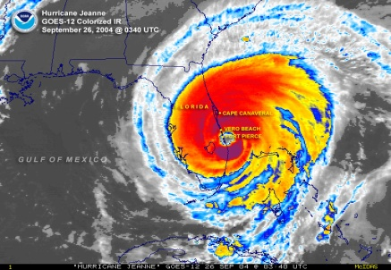
Commercial Residential Model
FPHLM
Low-Rise
Florida Public Hurricane Loss Model
Notes:
Draft for the question 1.
Responded by: Boback
Submitted to: Prof. Pinelli

Slide 23
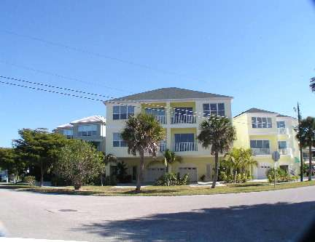
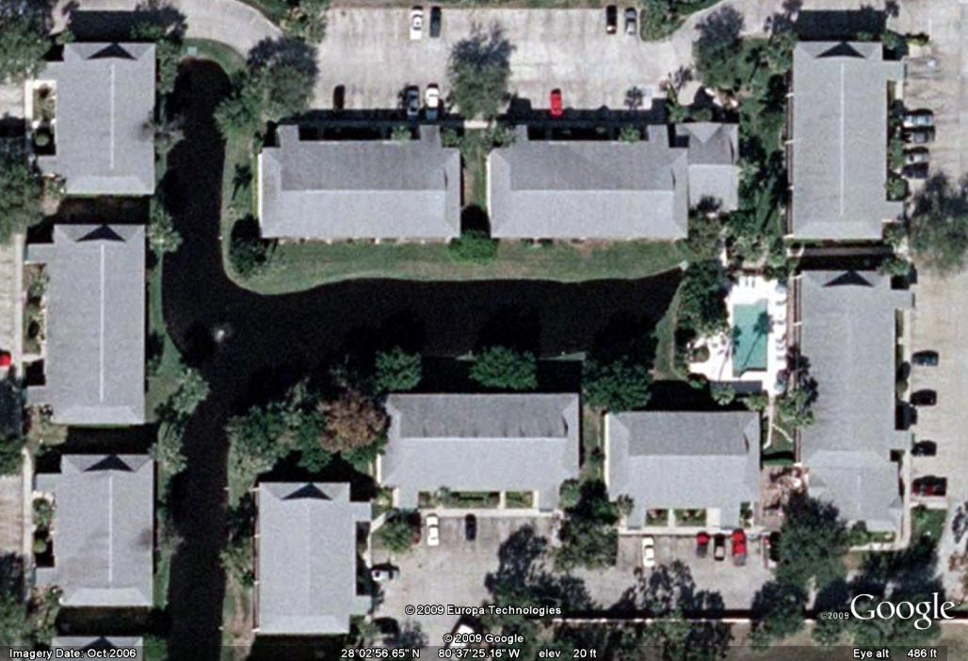
Low-rise commercial residential:1-3 stories mainly apartment buildings
Overview slide 23

Slide 24
Low-rise Modeling
Low-rise buildings are very similar to single-family-homes
  Can be categorized in a few typical generic buildings
  Can suffer substantial external structural damage (in addition to envelope and interior damage) including complete collapse
  Modeling approach is similar to single family homes: the building is modeled as a whole
Overview slide 24

Slide 25
Low-Rise Buildings Components
Type: e.g., Concrete Block, Gable Roof
Selected components
  Roof cover
  Roof sheathing
  Overhang
  Gable end trusses
  Roof to wall connections
  Wall covering
  Wall sheathing
  Openings: windows, sliding doors, entry doors
  Soffits
Overview slide 25
Notes:
25
A typical residential house is modeled as shown. It has five possible damage mode:
Roof cover failure
Sheathing failure
Opening failure
Wall failure
Wall to roof connection failure

Slide 26
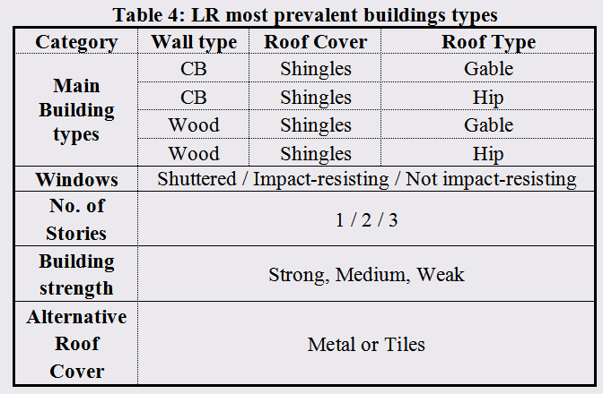
Low-rise building main types
Building Types
Overview slide 26

Slide 27
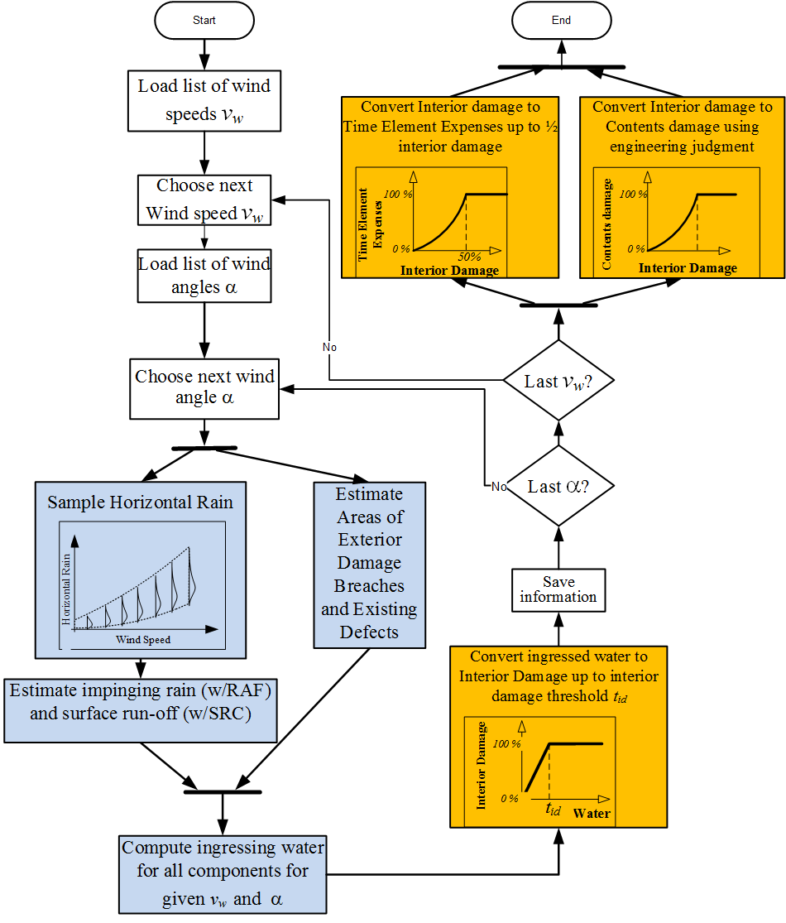
Low rise model
Overview slide 27
Notes:
27

Slide 28
Commercial Residential Model
FPHLM
Mid/High-Rise
Florida Public Hurricane Loss Model
Notes:
Draft for the question 1.
Responded by: Boback
Submitted to: Prof. Pinelli

Slide 29
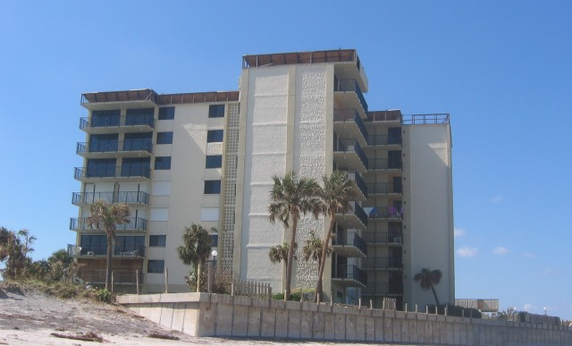
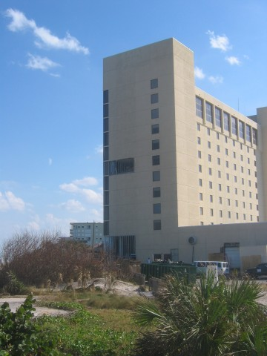
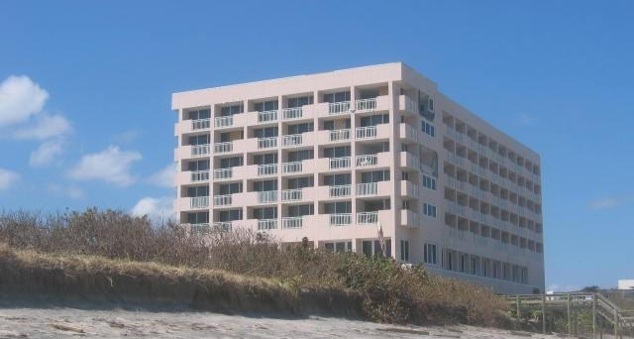
Variety of mid/high-rise buildings: 4+ stories
mainly condominium buildings
Overview slide 29

Slide 30
Mid-rise Modeling
Mid-rise buildings are very different to single-family-homes
  They are highly variable in shape, height, material, etc
  Cannot be categorized in a few generic building types
  Engineered structures that suffer little external structural damage and are unlikely to collapse
  Can suffer extensive cladding and opening damage leading to water penetration and interior damage
  FPHLM adopts a modular approach : the building is treated as a collection of apartment units
Overview slide 30

Slide 31
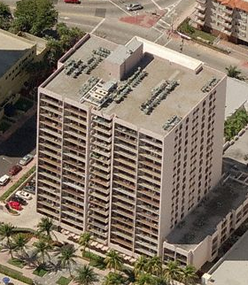
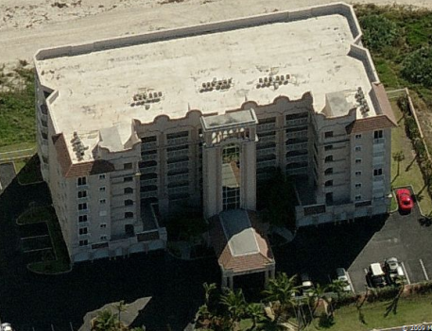
Mid-high rise
buildings characterization
Closed Building
Open Building
Overview slide 31

Slide 32
MHRB
Modular Unit Components
Type: e.g., Enclosed building, Corner Unit, No shutters, 6 windows
Selected components
  Windows
  Entry Door
  Sliding Door
Action
  Pressure
  Impact
State
  undamaged
  Damaged but not breached
  Damaged and breached
Overview slide 32
Notes:
32

Slide 33
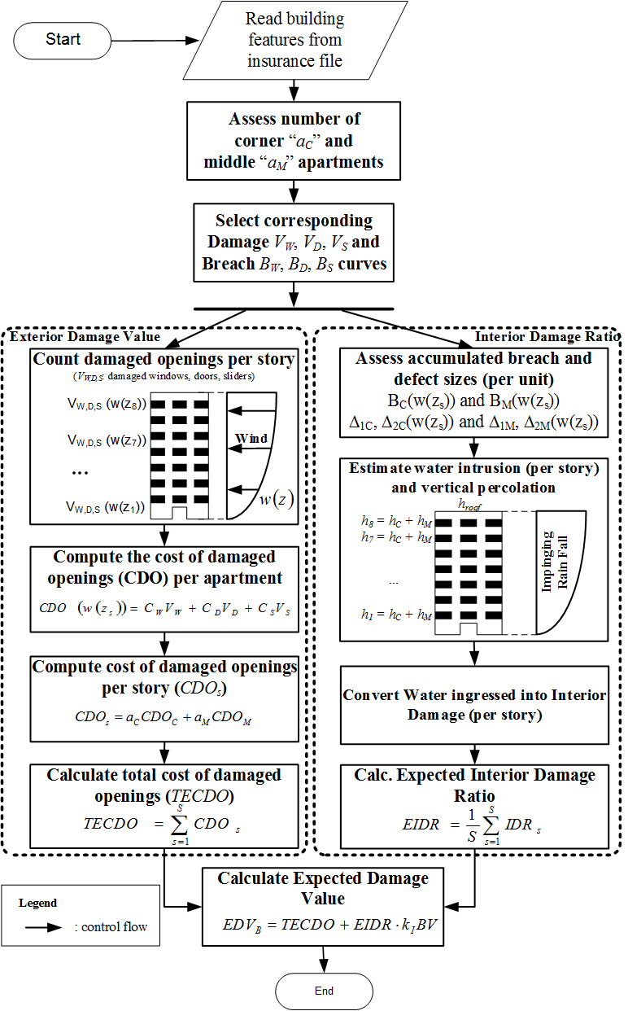
Vulnerabilty Model
of
mid/high-rise
buildings
(MHRB)
Overview slide 33

Slide 35
Vulnerability Model Changes
Florida Public Hurricane Loss Model

Slide 36
Changes
Low-rise Commercial Residential Model:
  Calculation of soffit areas
  Updates to wind driven rain model
  Update of exposure statistics, leading to changes in the weighted matrices.
Personal Residential Model:
  Update of exposure statistics, leading to changes in the weighted matrices

Slide 37
Soffit area
V6.1 Recessed soffit
V6.2 Flush soffit
Effect of the change is an increase in vulnerability, mainly at wind speeds under 200mph.

Slide 38
Wind Driven Rain Model
Two minor adjustments made to the method of sampling wind driven rain parameters
Effects: the two changes come close to cancelling each other out, with minimal change in overall loss

Slide 39
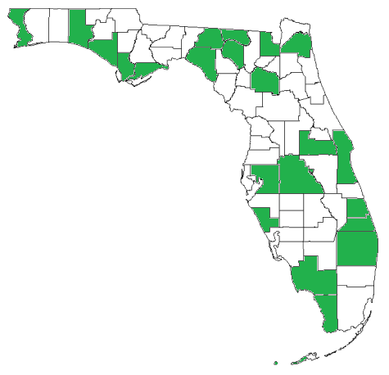
Exposure Statistics: Low-rise commercial residential
A new exposure study involved 22 Florida counties leading to a new set of statistics used to weight the vulnerability matrices.
Michalski, J., (2016) Building Exposure Study in the State of Florida and Application to the Florida Public Hurricane Loss Model, Master thesis, Department of Civil Engineering and Construction Management, Florida Tech, Melbourne, FL.

Slide 40
Exposure Statistics: Personal Residential
A new exposure study brought the dataset up to 51 counties, accounting for approximately 97% of Florida’s population.

Slide 41
Standard V-1
Derivation of Vulnerability Functions
Florida Public Hurricane Loss Model
Notes:
This is a joint effort funded by the Florida Department of Insurance, through the International Hurricane Center at FIU. Other participants in the project include NOAA and FSU for the meteorological model.

Slide 42
Standard V-1
Florida Public Hurricane Loss Model
A. Development of the building vulnerability functions shall be based on at least one of the following: (1) insurance claims data (2) laboratory or field testing, (3) rational structural analysis, and (4) post-event site investigations. Any development of the building vulnerability functions based on rational structural analysis, post-event site investigations, and laboratory of field testing shall be supported by historical data.
The development of the vulnerabilities is based on a component approach that combines engineering modeling, simulations with engineering judgment, and insurance claim data. The determination of external damage to buildings is based on structural calculations, tests, and Monte Carlo simulations. The wind loads and strength of the building components in the simulations are based on laboratory and in-situ tests, manufacturer’s data, expert opinion based on post-hurricane site inspections of actual damage, and codes and standards, and are calibrated and validated against insurance claim data. The internal and content damage are extrapolated from the external damage on the basis of expert opinion and site inspections of areas impacted by recent hurricanes and are confirmed using insurance claims data.
V-1 slide 42
Notes:
This is a joint effort funded by the Florida Department of Insurance, through the International Hurricane Center at FIU. Other participants in the project include NOAA and FSU for the meteorological model.

Slide 43
Standard V-1
Florida Public Hurricane Loss Model
B. The derivation of the building vulnerability functions and their associated uncertainties shall be theoretically sound and consistent with fundamental engineering principles.
The method used in the derivation is based on extrapolating the results of Monte Carlo simulations of physical exterior damage through simple equations based on engineering judgment, expert opinion, and claims data. Uncertainties at each stage are accounted for by distributing the damage according to reasonable probability distributions and are validated with claims data.
The Monte Carlo component models take into account many variations in structural characteristics, and the result clearly filters through the cost estimation model. There are also different and clearly defined costing considerations applied to each structural type. These adjustments come directly from resources developed exclusively for defining repair costs to structures and therefore are theoretically sound.
V-1 slide 43
Notes:
This is a joint effort funded by the Florida Department of Insurance, through the International Hurricane Center at FIU. Other participants in the project include NOAA and FSU for the meteorological model.

Slide 44
Standard V-1
Florida Public Hurricane Loss Model
C. Residential building stock classification shall be representative of Florida construction for personal and commercial residential buildings.
A detailed exposure study was carried out to define the most prevalent construction types and characteristics in the Florida residential building stock. Models were built for each of the identified common structural types. The low-rise models include differing wall types, roof shapes, roof-to-wall connections, window types, opening protection, garage doors, and story options.
Models of varying combinations of the above characteristics were created. The probabilistic capacities of the various components were determined by a variety of sources, including test results in the literature, in-field data collection, manufacturer’s specifications and manufacturer’s test data.
In the case of the mid-/high-rise commercial residential model, the models include different apartment units corresponding to different building layouts, different locations within the floor plan, different heights, and different openings and protection options.
V-1 slide 44
Notes:
This is a joint effort funded by the Florida Department of Insurance, through the International Hurricane Center at FIU. Other participants in the project include NOAA and FSU for the meteorological model.

Slide 45
Standard V-1
Florida Public Hurricane Loss Model
D. Building height/number of stories, primary construction material, year of construction, location, building code, and other construction characteristics, as applicable, shall be used in the derivation and application of building vulnerability functions.
The models include options that represent building code revisions. Three models were derived for each structural type: weak, medium, and strong construction. The assignment of a given strength is based on the age of the home and the available information on construction practice in that era of construction. FBC requirements that apply to the repair of existing homes are also taken implemented. Separate models were also developed for manufactured housing constructed based on pre- and post-1994 HUD regulations and for different wind zones.
In addition to the construction type, region, and era of construction options, each model has additional strength features that can be adjusted to represent combinations of mitigation features. For example the model is capable of reflecting weak original construction and new, strong roof sheathing and roof cover mitigation.
V-1 slide 45

Slide 46
Standard V-1
Florida Public Hurricane Loss Model
E. Vulnerability functions shall be separately derived for commercial residential building structures, personal residential building structures, manufactured homes, and appurtenant structures.
The commercial and personal residential building structures, mobile homes, and appurtenant structures are independently derived.
V-1 slide 46
Notes:
This is a joint effort funded by the Florida Department of Insurance, through the International Hurricane Center at FIU. Other participants in the project include NOAA and FSU for the meteorological model.

Slide 47
Standard V-1
Florida Public Hurricane Loss Model
F. The minimum windspeed that generates damage shall be consistent with fundamental engineering principles.
The minimum one-minute average sustained wind speed at which some damage is observed is 38 mph (3-second gust 50 mph) for appurtenant structures. Site-built and manufactured homes have a very small probability of some very minor damage at 42 mph (3-second gust 55 mph). This probability becomes more significant at 46 mph (3-second gust 60 mph) and increases with higher wind speed. Simulations are run for 3-second gusts from 50 mph to 250 mph in 5 mph increments.
V-1 slide 47
Notes:
This is a joint effort funded by the Florida Department of Insurance, through the International Hurricane Center at FIU. Other participants in the project include NOAA and FSU for the meteorological model.

Slide 48
Standard V-1
Florida Public Hurricane Loss Model
Building vulnerability functions shall include damage as attributable to windspeed and wind pressure, water infiltration, and missile impact associated with hurricanes. Building vulnerability functions shall not include explicit damage to the building due to flood, storm surge, or wave action.
The vulnerability functions do not explicitly include damage due to flood, storm surge, or wave action. The vulnerability functions for all models (site-built residential, manufactured homes, low-rise commercial residential, and mid-/high-rise commercial residential) include damage due to wind pressure, missile impact and water infiltration.
V-1 slide 48
Notes:
This is a joint effort funded by the Florida Department of Insurance, through the International Hurricane Center at FIU. Other participants in the project include NOAA and FSU for the meteorological model.

Slide 49
Standard V-2
Derivation of Contents and Time Element Vulnerability Functions
Florida Public Hurricane Loss Model
Notes:
This is a joint effort funded by the Florida Department of Insurance, through the International Hurricane Center at FIU. Other participants in the project include NOAA and FSU for the meteorological model.

Slide 50
Standard V-2
Florida Public Hurricane Loss Model
A. Development of the contents and time element vulnerability functions shall be based on at least one of the following: (1) insurance claims data, (2) tests, (3) rational structural analysis, and (4) post-event site investigations. Any development of the contents and time element vulnerability functions based on rational structural analysis, post-event site investigations, and tests shall be supported by historical data.
The development of the vulnerabilities is based on a component approach that combines engineering modeling, simulations with engineering judgment, and insurance claims data. The content and time element vulnerabilities are extrapolated from the building damage on the basis of expert opinion and post-events site investigations of areas impacted by recent hurricanes and are confirmed using historical claims data.
V-2 slide 50
Notes:
This is a joint effort funded by the Florida Department of Insurance, through the International Hurricane Center at FIU. Other participants in the project include NOAA and FSU for the meteorological model.

Slide 51
Standard V-2
Florida Public Hurricane Loss Model
B. The relationship between the modeled building and contents vulnerability functions and historical building and contents losses shall be reasonable.
The relationship between the modeled structure and the contents vulnerability functions is reasonable, on the basis of the relationship between historical structure and contents losses.
V-2 slide 51
Notes:
This is a joint effort funded by the Florida Department of Insurance, through the International Hurricane Center at FIU. Other participants in the project include NOAA and FSU for the meteorological model.

Slide 52
Standard V-2
Florida Public Hurricane Loss Model
C. Time element vulnerability function derivations shall consider the estimated time required to repair or replace the property.
Time element vulnerability function derivations consider the estimated time required to repair or replace the property.
V-2 slide 52
Notes:
This is a joint effort funded by the Florida Department of Insurance, through the International Hurricane Center at FIU. Other participants in the project include NOAA and FSU for the meteorological model.

Slide 53
Standard V-2
Florida Public Hurricane Loss Model
D. The relationship between the modeled building and time element vulnerability functions and historical building and time element losses shall be reasonable.
For Personal Residential risks the model uses time element vulnerability functions derived from the relationship between building damage and additional living expense. The vulnerability functions have been calibrated using historical claims data on building and additional living expense.
For Commercial Residential risks the relationship between modeled structure and time element loss costs is reasonable. Since no historical loss data were available for calibration, the relationship combines engineering and actuarial judgment.
V-2 slide 53
Notes:
This is a joint effort funded by the Florida Department of Insurance, through the International Hurricane Center at FIU. Other participants in the project include NOAA and FSU for the meteorological model.

Slide 54
Standard V-2
Florida Public Hurricane Loss Model
E. Time element vulnerability functions used by the model shall include time element coverage claims associated with wind, flood, and storm surge damage to the infrastructure caused by a hurricane.
The time element vulnerability functions produced by the model consider time element claims arising from wind, flood, and storm surge damage to the infrastructure. The model does not distinguish explicitly between direct and indirect loss. For Personal Residential risks the time element vulnerability functions were calibrated against claims data that include both types of losses. For Commercial Residential risks the recognition of claims due to indirect loss is based on judgment since no historical loss data were available for calibration.
V-2 slide 54
Notes:
This is a joint effort funded by the Florida Department of Insurance, through the International Hurricane Center at FIU. Other participants in the project include NOAA and FSU for the meteorological model.

Slide 55
Standard V-3
Mitigation Measures
Florida Public Hurricane Loss Model
Notes:
This is a joint effort funded by the Florida Department of Insurance, through the International Hurricane Center at FIU. Other participants in the project include NOAA and FSU for the meteorological model.

Slide 56
Standard V-3
Florida Public Hurricane Loss Model
A. Modeling of mitigation measures to improve a building’s hurricane wind resistance, the corresponding effects on vulnerability, and their associated uncertainties shall be theoretically sound and consistent with fundamental engineering principles. These measures shall include fixtures or construction techniques that enhance the performance of the building and its contents and shall consider:
    Roof strength
    Roof covering performance
    Roof-to-wall strength
    Wall-to-floor-to-foundation strength
    Opening protection
    Window, door, and skylight strength.
Modeling of mitigation measures to improve a building’s hurricane wind resistance, the corresponding effects on vulnerability, and their associated uncertainties is theoretically sound and consistent with fundamental engineering principles.
V-3 slide 56
Notes:
This is a joint effort funded by the Florida Department of Insurance, through the International Hurricane Center at FIU. Other participants in the project include NOAA and FSU for the meteorological model.

Slide 57
Standard V-3
Part A: Continued
The following structures were modeled:
Base case as defined by Commission
Mitigated case as defined by Commission
Base plus one mitigation at a time
The mitigations included gable bracing, rated shingles, metal roof, stronger sheathing capacity, stronger roof-to-wall connections, stronger wall-to-sill connections, reinforced masonry walls, multiple opening protection options, and wind/missile resistant glass.
V-3 slide 57

Slide 58
Standard V-3
Florida Public Hurricane Loss Model
B. Application of mitigation measures that enhance the performance of the building and its contents shall be justified as to the impact on reducing damage whether done individually or in combination.
The base cases are very weak cases, where the interior damage is governed by the sheathing loss at low to moderate wind speeds. Application of mitigation measures are justified, as they reduce damage relative to the base case individually, and compound the reduction of damage in combination.
V-3 slide 58
Notes:
This is a joint effort funded by the Florida Department of Insurance, through the International Hurricane Center at FIU. Other participants in the project include NOAA and FSU for the meteorological model.

Slide 59
Response to Commission issues
Florida Public Hurricane Loss Model
Reference Document: FPM Deficiency Letter 15 Standards
December 14, 2016

Slide 60
Investigate the condo-unit floor location impact on loss costs. How is lack of floor location treated?
Loss increases with unit height due to wind speed
Lack of floor location treatment:
  Compute loss at each floor height and take the average

Slide 61
Investigate aspects of the model and inputs that could lead to the greatest reduction in the uncertainty in model outputs (e.g., hurricane frequency, damage functions, incorrect data input, granularity of exposure location (ZIP Code centroid versus street address) data input).
Contents of portfolios and T.A. databases with respect to structural features
Inconsistencies within data (missing fields, etc.)
Capturing of pulled permits for re-roofing (claims and portfolios)

Slide 62
Investigate how contamination of claims data (flood loss counted as wind loss) impacts validation and model output.
Wind claims data with contamination from flood damage are excluded from the validation sets.
For example, Hurricane Ivan in certain regions of the panhandle are very likely contaminated, and therefore not used.

Slide 63
Investigate how the treatment of inland versus coastal exposures has an effect on the spatial evaluation of vulnerability functions.
The spatial distribution of appropriate vulnerability functions vary by region according to the county-by-county exposure study. Primarily the age of the structure is used to assign an appropriate vulnerability model with strength consistent with construction in that era. The distribution of age varies among regions.
With respect to coastal vs inland, coastal vulnerability models are more heavily weighted toward window protection versions. Miami-Dade HVHZ is accounted for with its own high-strength model to reflect code requirements.

